Slide 1


External Relations & Advancement
Board of Visitors Presentation
September 2025
Notes:
Honorary Campaign Co-Chairs
Endowed Chairs
143K
49K

Slide 2
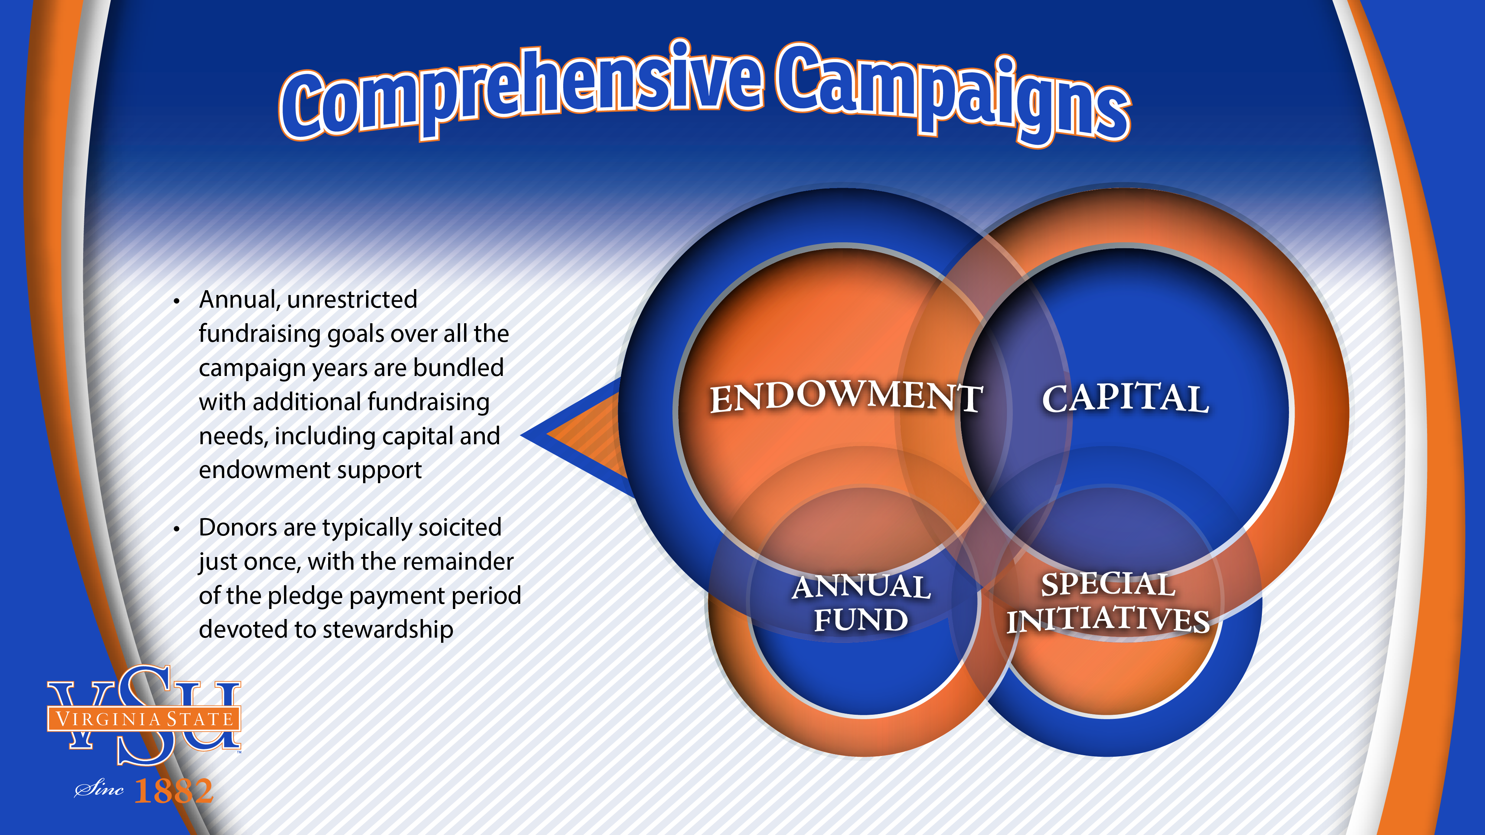
solicited
Notes:
What is a Comprehensive Campaign?
Comprehensive campaigns bundle annual fund goals over several years with extraordinary fundraising needs, such as capital or endowment support.
While this approach to major gifts fundraising may not be as familiar and therefore may require more coordination and consistency in your messaging, there are many benefits:
Since donors are typically solicited just once for a multi-year gift, you’ll have more time for stewardship and donor engagement;
The opportunity to make the case for increasing unrestricted gifts to build infrastructure, or respond to unique challenges and opportunities in your environment;
Your entire universe of donors will be included in the campaign effort – everyone’s gift counts.
Greater volunteer participation and leadership -- these campaigns can appeal to a wider audience.

Slide 3







VSU is following a variety of campaign models
Category
Peer¹
Aspirational¹
University Name
Clark Atlanta University
Bowie State
NCAT
Xavier University
Campaign Name
Lifting Lives, Leading the Way
BSU BOLD: The Campaign for Excellence
Power of Do Campaign
Press Forward, Fear Nothing
Priorities
- Scholarship & Student Success
- Teaching, Research, and Service
- CAU Endowment
- Infrastructure and Technology
- Entrepreneurial Ecosystem
- Health Care Workforce
- Elevating the Arts
- Athletics Programs
- Advancing Social Justice
- Enabling Student Success
Merit Scholarships
New Academic Programs
Faculty Research
University Visibility Initiatives
Affordability and Access
Student Well-Being and Success
Matching Our Campus Potential
Recruiting and Retaining Exceptional Faculty and Expanding Programs
Goal
$250M goal by Dec 2032
$50M by Dec 2025
$100M by Dec 2020
$500M in 5-7 years
Timeline
2022-2032
2021-2025
2012-2020
2022-2029
Featured Capital Projects?
Yes
$50M infrastructure goal for enhancing facilities, student housing, and labs
No
No
Yes
$105M goal for campus improvements (e.g., library, HVAC renovations, pedestrian bridge)
1. Peer and aspirational case studies are based on initiative owner recommendations

Slide 4

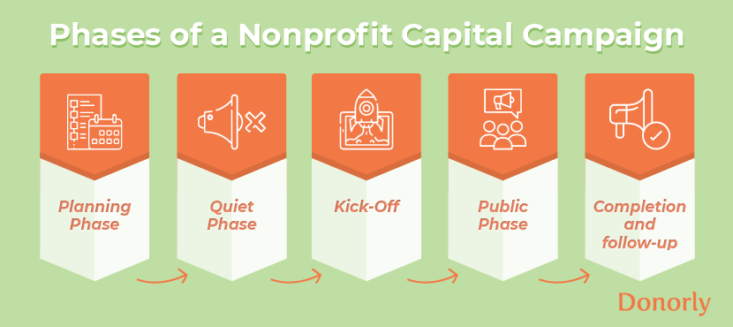
Currently in the Quiet or Silent Phase
PHASES OF A COMPREHENSIVE CAMPAIGN

Slide 5


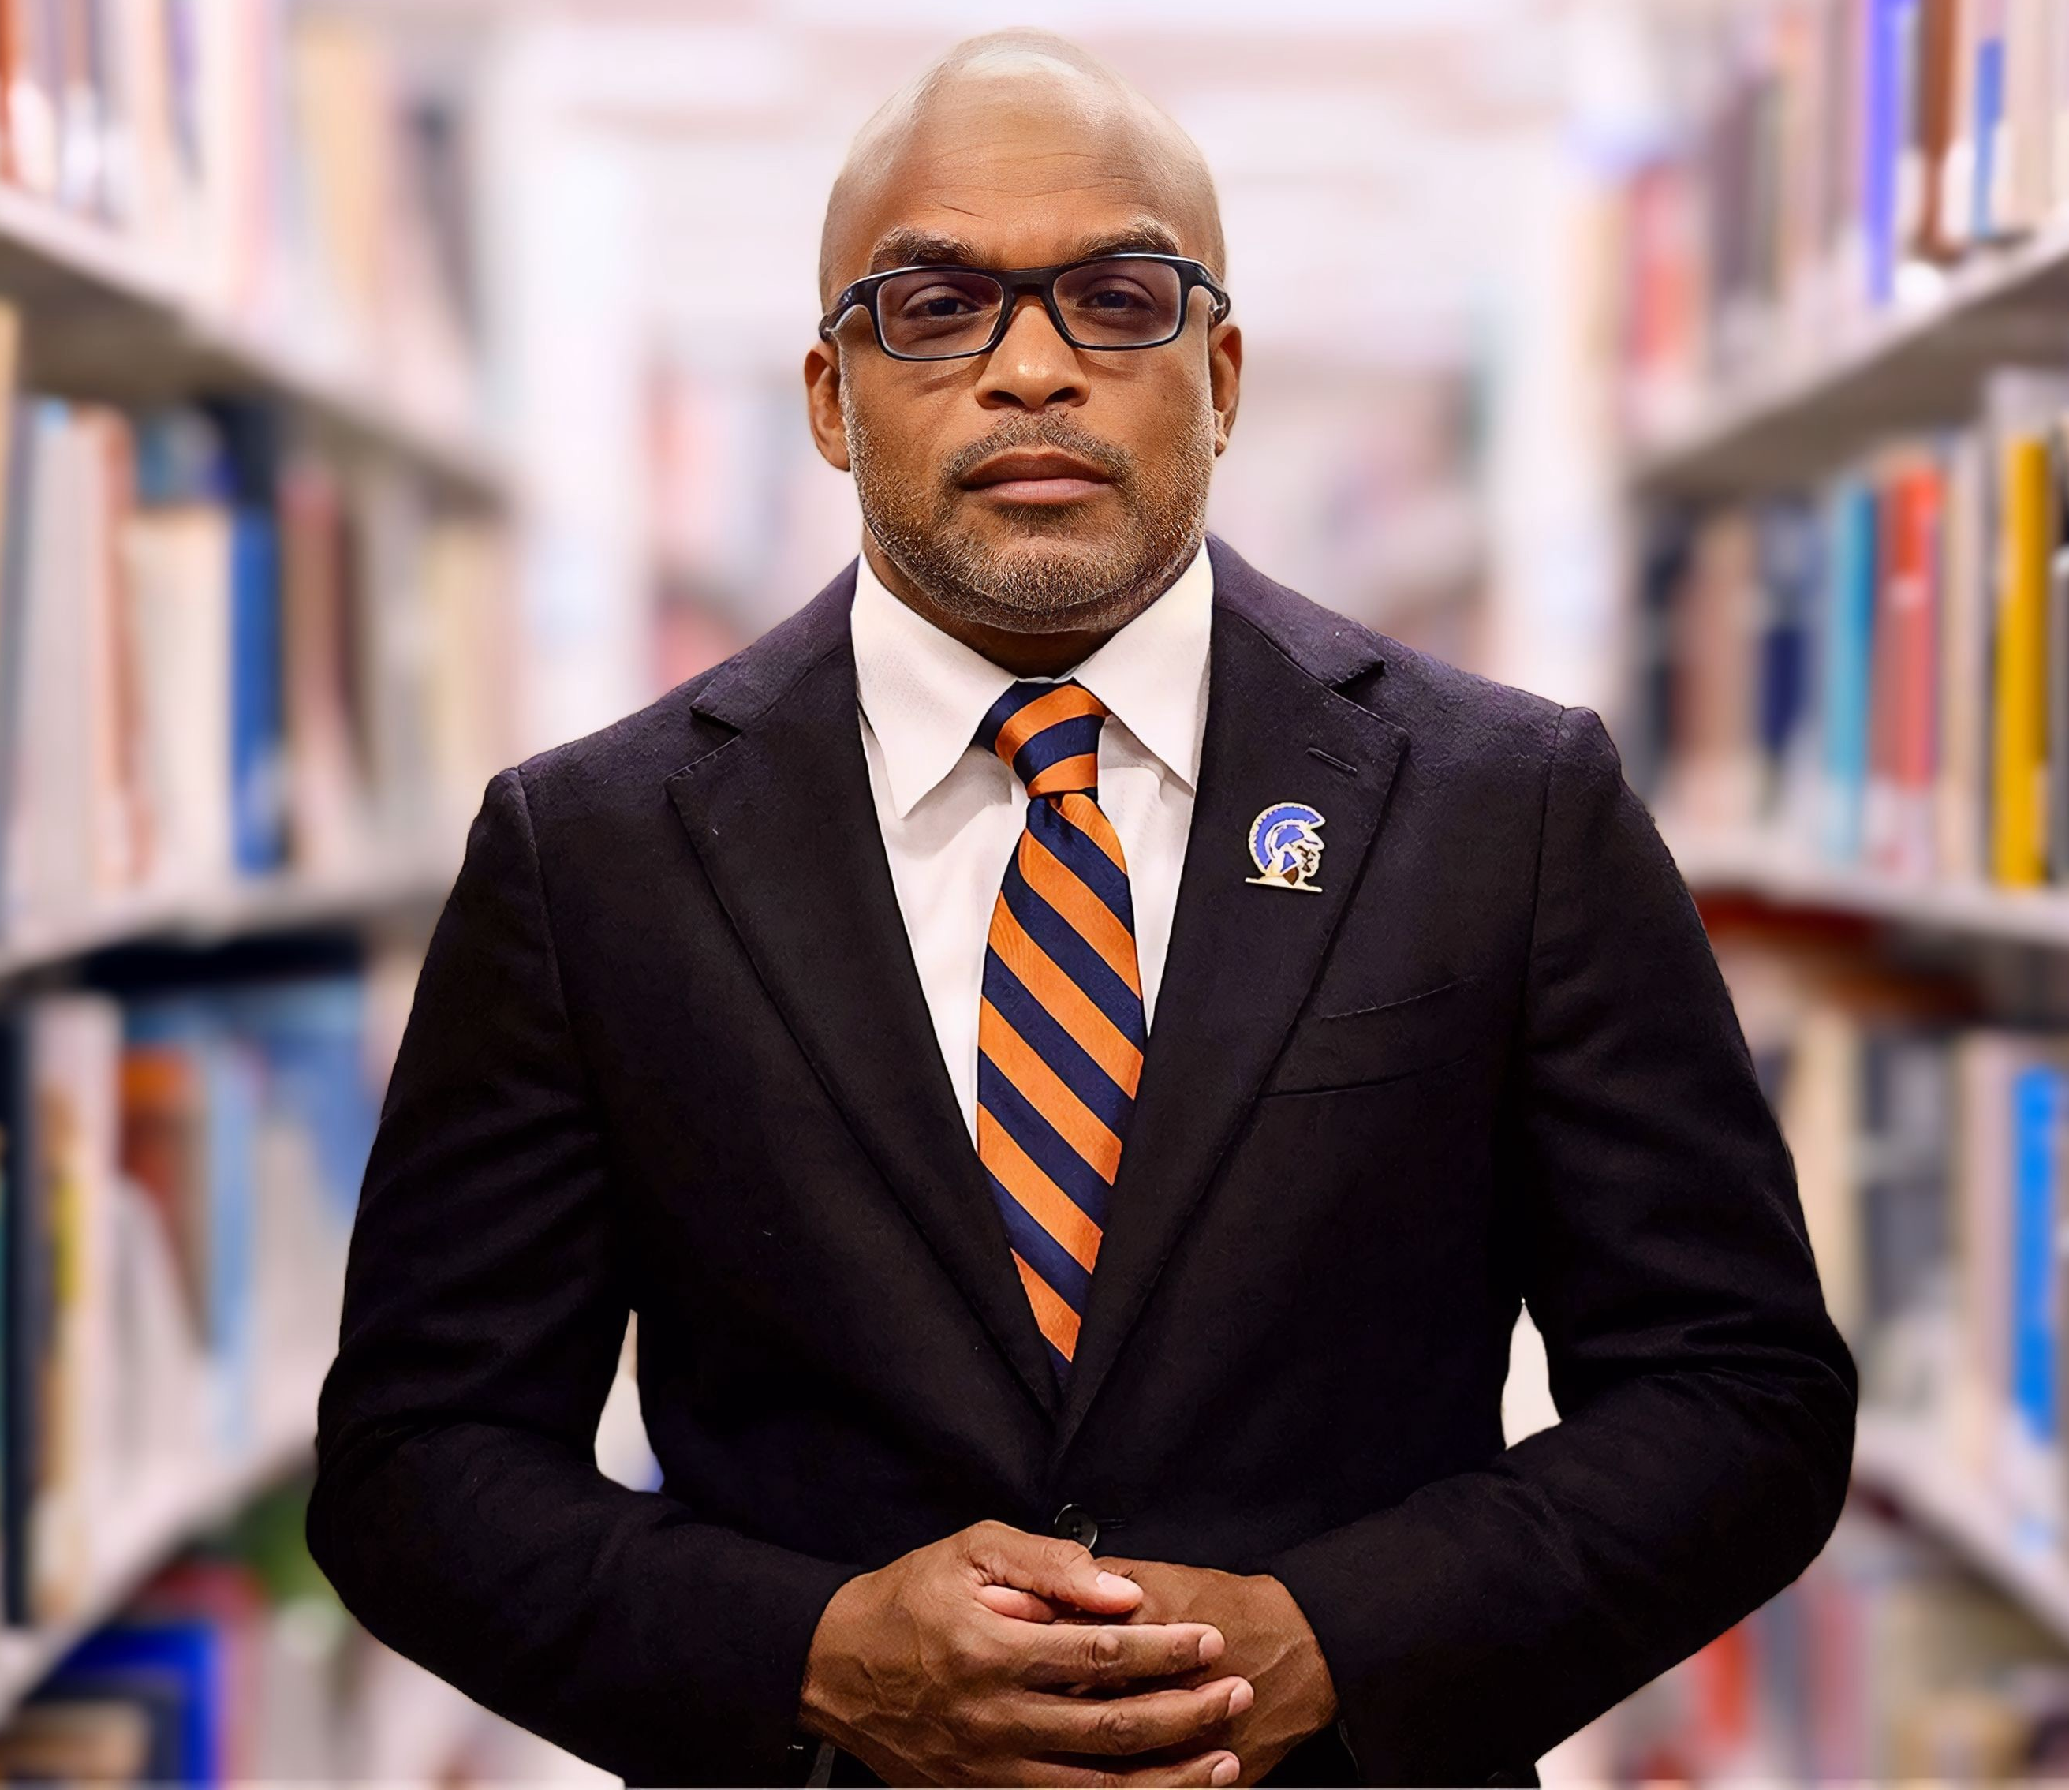
Multi-year campaign that celebrates Dr. Abdullah and VSU’s 145 years…
Potential key actions & goals
Conduct preliminary analysis on areas of giving after M. Scott Donation
Define pillars of the campaign and the preliminary list of projects
Identify campaign manager and advisory council
2020-2023
2023-2024
Finalize project goals based on determined needs for private donations
Complete prospect research and launch silent phase
2024-2025
Begin planning fundraising events, targeted solicitation, and town hall style meetings
Determine timeline for announcement of public phase
2025-2026
Launch public solicitation for campaign gifts including events and broader solicitation
Begin collecting pledges
2026-2027
Launch celebratory year of VSU 145 anniversary with VSU Advancement’s signature event
Finish collecting pledges and donor recognition
Goal: $100M by May 2030

Slide 6
Year-End Dashboard
 | FY_2025 |  | FY_2024 |  | FY Differences
 | DOLLARS | DONORS | DOLLARS | DONORS | DOLLARS | DONORS
Grand Total | $4,380,311.68 | 2686 | $5,027,646.06 | 1964 | -167,946.01 | 722
ALUMNI | $1,106,444.79 | 1704 | $974,897.32 | 1313 | $131,547.47 | 391
ALUMNI ASSOC | $43,303.00 | 11 | $68,073.06 | 13 | -$24,770.06 | -2
CORP/FDN/ORG | $2,759,522.39 | 162 | $3,533,181.84 | 154 | -$773,659.45 | 8
FACULTY & STAFF | $80,717.80 | 84 | $97,568.68 | 80 | -$16,850.88 | 4
FRIENDS/INDVLS | $380,448.70 | 648 | $350,461.10 | 376 | $29,987.60 | 272
PARENTS | $4,320.00 | 34 | $2,680.00 | 11 | $1,640.00 | 23
STUDENTS | $5,555.00 | 43 | $784.06 | 17 | $4,770.94 | 26

Slide 7








Advancement Communication Enhancements
Strategic vision
Clear impact
Donor recognition
Community giving
Main priorities of campaign and strategic plan alignment are summarized
Direct messaging around impact of giving and clear next steps to learn more
Designated spaces to recognize individual and corporate donors
Highlighted giving circles and events with options for sharing over social media
Various giving paths
Tailored giving
Streamlined giving
Accessible support
Clearly indicates how to participate in gift matching, establish recurring gifts, etc.
Department or fund specific giving opportunities clearly highlighted
Gift page has concise wording, limited fields, and/or suggested giving amounts
Clear contact information for advancement team and language that encourages outreach
Source: Funraise 2022 and 2023 Annual Report Manual
Notes:
7

Slide 8









New Features for the Comprehensive Campaign
Donor recognition
Tailored giving
Clear impact
Strategic vision
Virtual donor wall
Multimedia content
Donor impact stories
Department-level selection
Events and campaigns
Include virtual donor wall where various giving groups are recognized, beyond major gifts
Update website bi-monthly with short-form video content highlighting donor impact, campaigns, and campus updates
Update website bi-monthly with impact stories highlighting students, department initiatives, etc.
Create clear pathways for donors to donate to specific priorities within the campaign
Clearly highlight the strategic alignment of current advancement initiatives, including upcoming campaign events

Slide 9




Using AI for Quick Wins in Advancement
Alumni Relations Staff
Use ChatGPT to generate personalized messages for alumni event invitations
Increase RSVP rates
Improve engagement
Proposal Writer
Utilize ChatGPT to create detailed grant proposals by analyzing past successful submissions and current funding trends
Enhance content
Boost success rates
Save time
Marketing Staff
Employ AI to create campaign videos for funding initiatives tailored to specific donor demographics
Drastically cut time and money spent in production to maximize impact
Prospect Research
Leverage ChatGPT to gather and summarize detailed background information on potential major donors
Develop comprehensive donor profiles that include interests, past giving behavior, and potential for future contributions
Source: EAB interviews and analysis.
Hi! Can you remind me what you used to do that poll during in day? where you could see in real time what people were voting for?
Notes:
We’ve heard other one-off examples of how staff members are or plan to use AI and we’ve included a few here.
For example, alumni relations staff have leveraged AI to personalize invites
Or proposal writers using ChatGPT to create a first draft based on templates
We’ve heard that prospect researchers are tried leveraging ChatGPT to gather background information, but have been warned that it doesn’t always work well. It often gets details wrong and misidentifies them. If you haven’t tried asking ChatGPT for your bio yet, I recommend it.

Slide 10

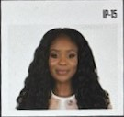
The First Autonomous Fundraiser
Version 2 Brings AI to the Frontlines
Version2 Launches the “World’s First Fully Autonomous Frontline Fundraiser”
Mission: Create and accelerate the advancement of autonomous fundraising technology and mimic the cognitive functions of a fundraising staff.
Goal: Autonomously manage a portfolio of donors, similar to the way a traditional fundraiser would.
Process: Narrows donor pool, qualifies donors, builds relationships through personalized touch points, solicits, closes, and executes stewardship without human interaction.
Source: Leahy, Kevin, “Version2 Launches with AI Lab Focused on Building World’s First Fully Autonomous Nonprofit Fundraiser”, EIN Presswire, 2024; Verion2.ai, 2024; EAB interviews and analysis.
Notes:
Say hello to the autonomous AI fundraiser- Alex.
Now before we dive in further, let me be clear- we’re not saying this is a best practice.
But we wanted to bring it to you all as something to observe
A company called Version2, created by Adam Martel former CEO of Gravity, believes there is room for AI frontline fundraisers.
Alex is supposed to qualify donors, build relationships, solicit and close gifts- all without donors getting human interaction.
A few institutions are trying this out and there has been quite a buzz about it on LinkedIn.
Now, I’m curious to get your thoughts on this because I know many will want to share. But I did want to let you know we tested Alex in the early days for an annual giving and she was a glorified chat bot that made it harder to give a gift without personalization. But since then I’ve heard she’s been improved.
Curious what your thoughts are?
Thanks for sharing. This may be clunky now, but know that something like this will be possible in the future and it will be up to you all to decide to deploy it or not.
research suggests top donors don’t want to give to institutions who are using AI.

Slide 11

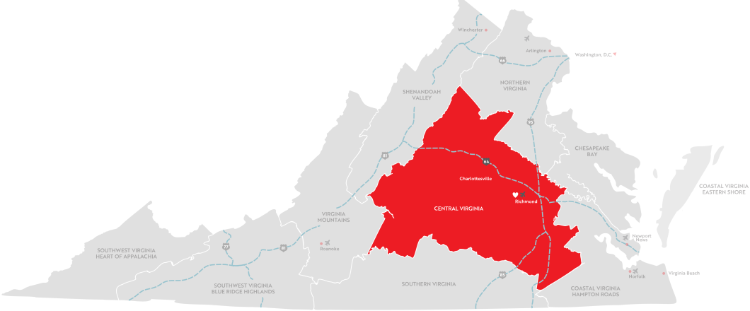
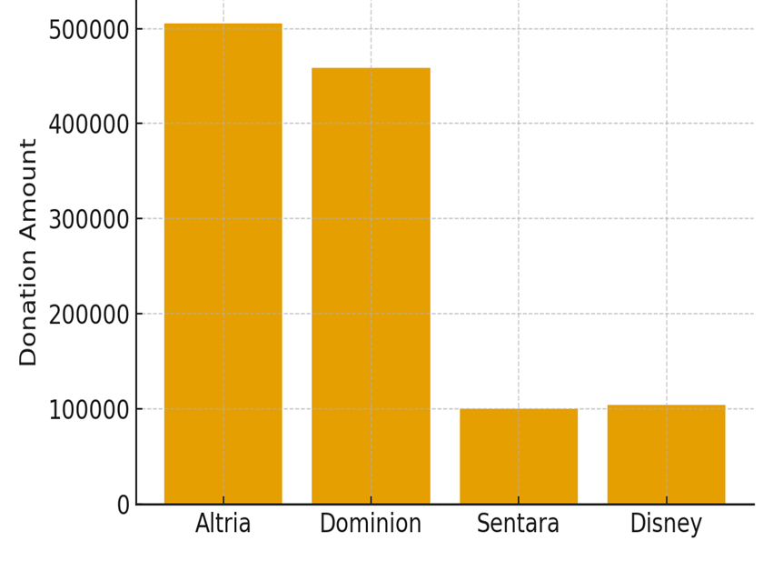
Courting More Corporations in and out of Virginia

Slide 12
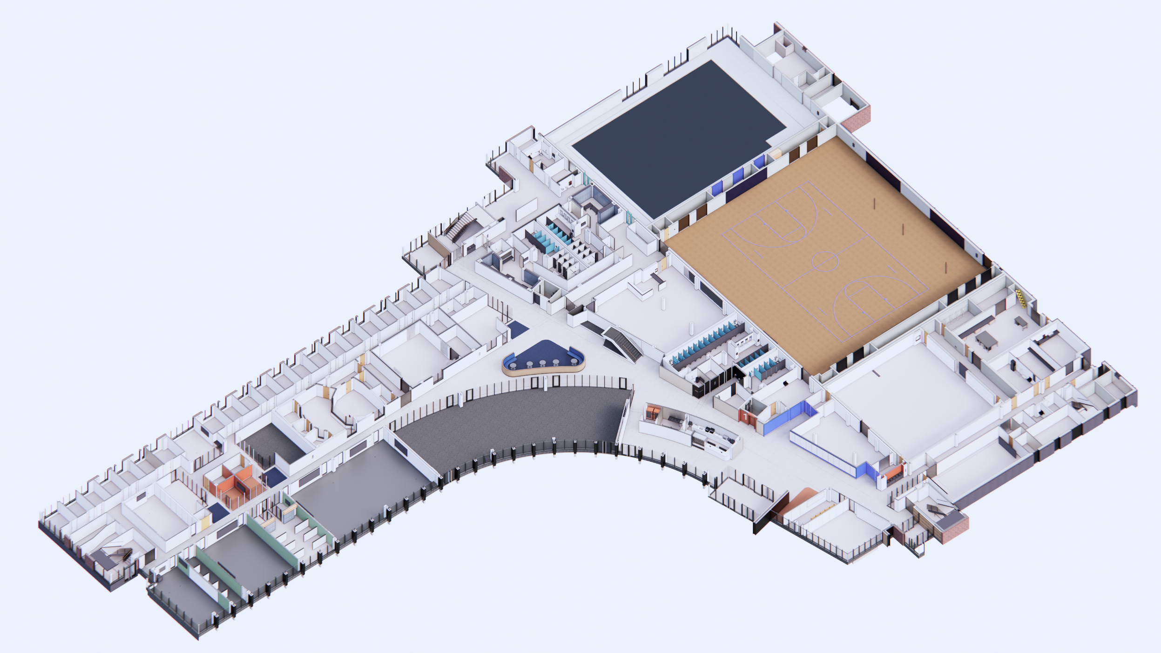
Naming Opportunities in New and Existing Buildings
VSU / Moments of Interest
POOL
GYM
BLACK BOX THEATER
DIGITAL SIGNAGE
STAIR FEATURE WALL
MEDIA CENTER
MEETING PLACE
MAIN FEATURE WALL
STUDY
ART GALLERY
DIGITAL SIGNAGE
EVENT FORUM
ENTRANCE COURT
CAFE
ENTRANCE

Slide 13
Office of Alumni Engagement Update
Franklin Johnson-Norwood
Assistant Vice President for Alumni Engagement and Advancement Services

Slide 14



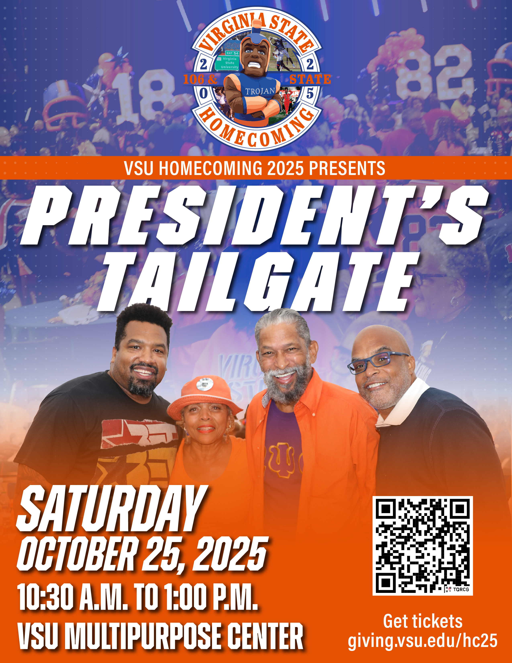
Homecoming 2025 Events

Slide 15
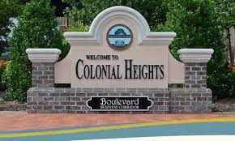
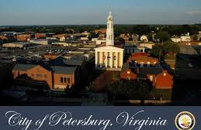
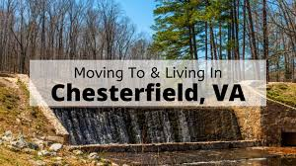
Other Signature Events Driving Engagement
Donor & Corporate AI Summit: Recognition & ROI Dashboard
President Abdullah’s 10th Anniversary Pre-Gala Receptions
Town & Gown Meetings- (Pre-Homecoming):
Colonial Heights
Petersburg
Chesterfield

Slide 16
Office of Communications Update
Dr. Gwen Williams Dandridge
Assistant Vice President for Communication

Slide 17


Slide 18
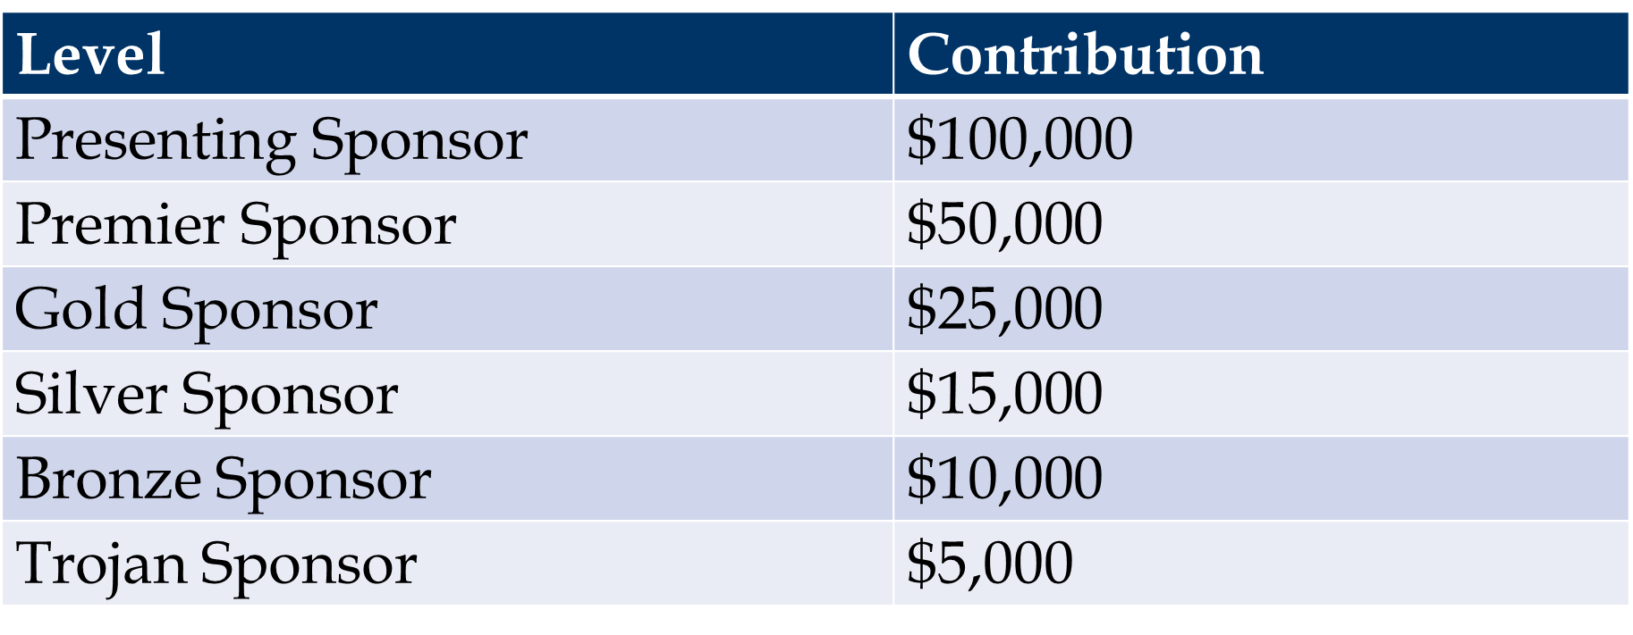
Gala Sponsorship Levels

Slide 19
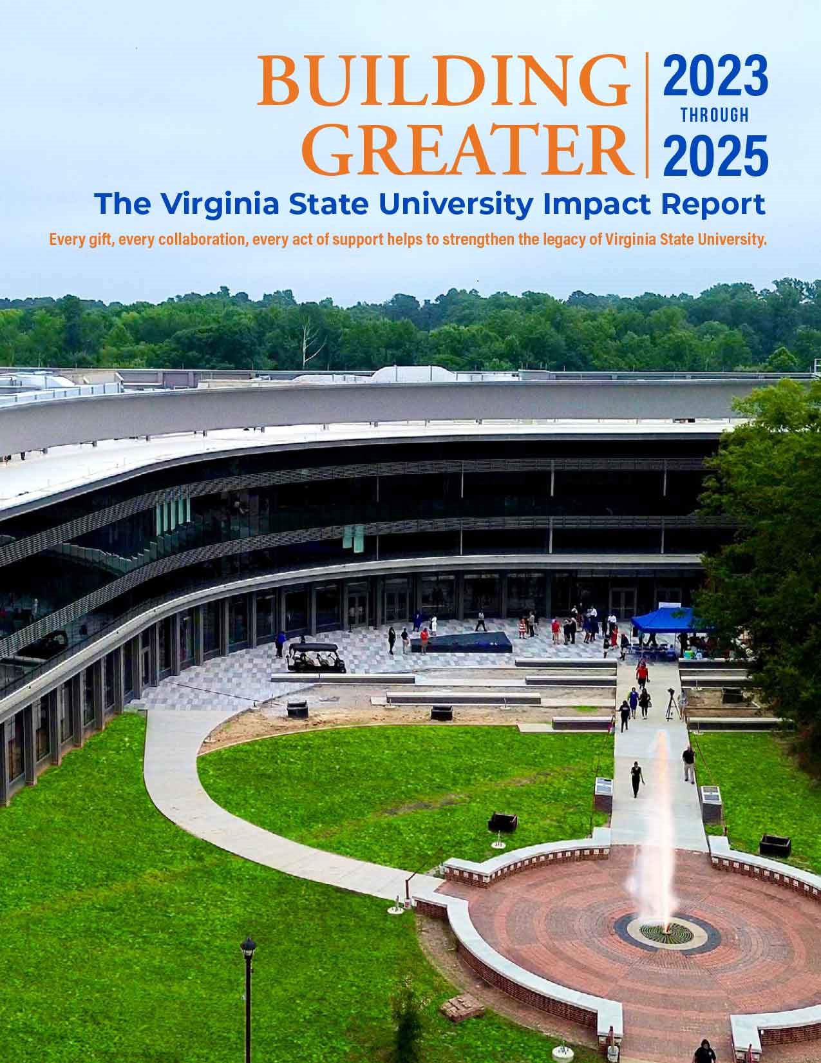
Centered around ROI:
Carnegie R2 Research Designation (2025)
Fulbright HBCU Institutional Leader (2024)
AI Workforce Development Grant (SCHEV, 2024)
Student Success: Engineering win, NASA Lunabotics
Campus Enhancements: Azurest South, PGA Golf Simulator

Slide 20
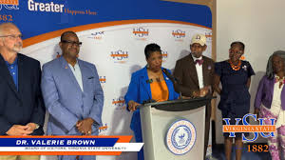
Closing & Greater Board Engagement
Shape VSU’s AI-driven philanthropic future
Board’s role: ambassadors and connectors
Message: Greater Happens Here — Together

Slide 21


